Slide 1




BDA in Healthcare using analytics tool
TAMILNADU SKILL DEVELOPMENT CORPORATION
Naan Mudhalvan Niral Thiruvizha
Yogeshwaran G (210220104032)
Sakthivel S (210220104022)
Manoj K (210220104013)
Sathish Kumar M (210220104025)
Guided by: Mrs R Sudha

Slide 2
Abstract:
Big Data Analytics (BDA) has significant attention in sectors such as healthcare
We aim to provide a comprehensive literature review on the application of big data analytics in healthcare
The study delves into various application areas of BDA in healthcare, highlights successful implementations, and explores their potential to enhance healthcare outcomes while reducing costs
Big data analytics in healthcare, aiming to push the boundaries and contribute to enhanced healthcare outcomes and decision-making

Slide 3
Introduction:
Our project “BDA in Healthcare with Prediction” has compromised of two sectors. One is analytics sector and another one is prediction sector.
The main purpose of this project is to show, to make people understand, to imply the effectiveness of analytics using the tool.
Our main goal for this project is to make people understand how important analytics for a healthcare or even any business field and also teach them the importance of analytics tool and its effectiveness.

Slide 4
Goal and objective:
GOAL:
BDA helps determine disease causes, generate effective diagnoses, and predict readmissions. BDA increases efficiency in healthcare delivery, improving the effectiveness and viability of treatments.
OBJECTIVE:
Improving patient outcomes
Operational efficiency
Research and innovation
Compliance and risk management

Slide 5
LITERATURE SURVEY:
BY ASWIN BELLE:
The rapidly expanding field of big data analytics has started to play a pivotal role in the evolution of healthcare practices and research
Big data analytics has been recently applied towards aiding the process of care delivery and disease exploration
Recent research which targets utilization of large volumes of medical data while combining multimodal data from disparate sources is discussed

Slide 6
LITERATURE SURVEY:
BY REVNATH SONATTI:
Data is a powerful resource which is found in many forms. Big data do not have a universal definition while it is discussed in different ways
Often big data is presumed to be scary, yet it is an explosion in the field of information
This significant heap of data often defined as three-dimensional namely Volume, Velocity and Variety
where some even define with Veracity.

Slide 7
LITERATURE SURVEY:
BY AMBIGAVATHI & SRIDHARAN:
The pace of both digital innovation and technology disruption is refining the healthcare industry at an exponential rate
big data is shifting the traditional way of data delivery into valuable insights using big data analytics method
Big data analytics tools play an essential role to analyze and integrate large volumes of structured, semi-structured and unstructured vital data rapidly produced by the various clinical

Slide 8
LITERATURE SURVEY
BY CLINPATH:
The paper aims at analyzing the possibilities of using Big Data Analytics in healthcare
Literature studies have shown that the use of Big Data Analytics can bring many beneﬁts to medical facilities
The research positively conﬁrmed that medical facilities are working on both structural data and unstructured data
However, the use of data from social media is lower as in their activity they reach for analytics

Slide 9
EXIXTSING SYSTEM:
Healthcare institutions are grappling with the challenge of effectively utilizing the vast amount of data generated within hospital systems
. This data, if harnessed effectively, holds immense potential to drive insights for improving overall efficiency
observed that current surveys remain focused on foundational basics and challenges in big data healthcare
, explored an architectural framework, and elucidated several application possibilities within the healthcare domain

Slide 10
Proposed system:
To predict the length of stay of patients and accommodation.
To Evaluate the average waiting time of patients
It predicts the result with more accuracy using which overstays and average waiting time can be reduced
This system can be used in all government hospitals, private hospitals, and even small clinics
This model will predict the length of stay and Patient visit on a monthly basis of all kinds of patients

Slide 11
Theoretical analysis:
. Our theories are not entirely new to analytics field or anything like that. In fact, the basic scratch was already developed
we made some minor augmentations to the point, where our whole target is to help all of those who wants to be a part of this project
The knowledge we possess a type of skillset which we use to interpret things
Using tools also require a specific skillset which helps as an integral part of analytics

Slide 12
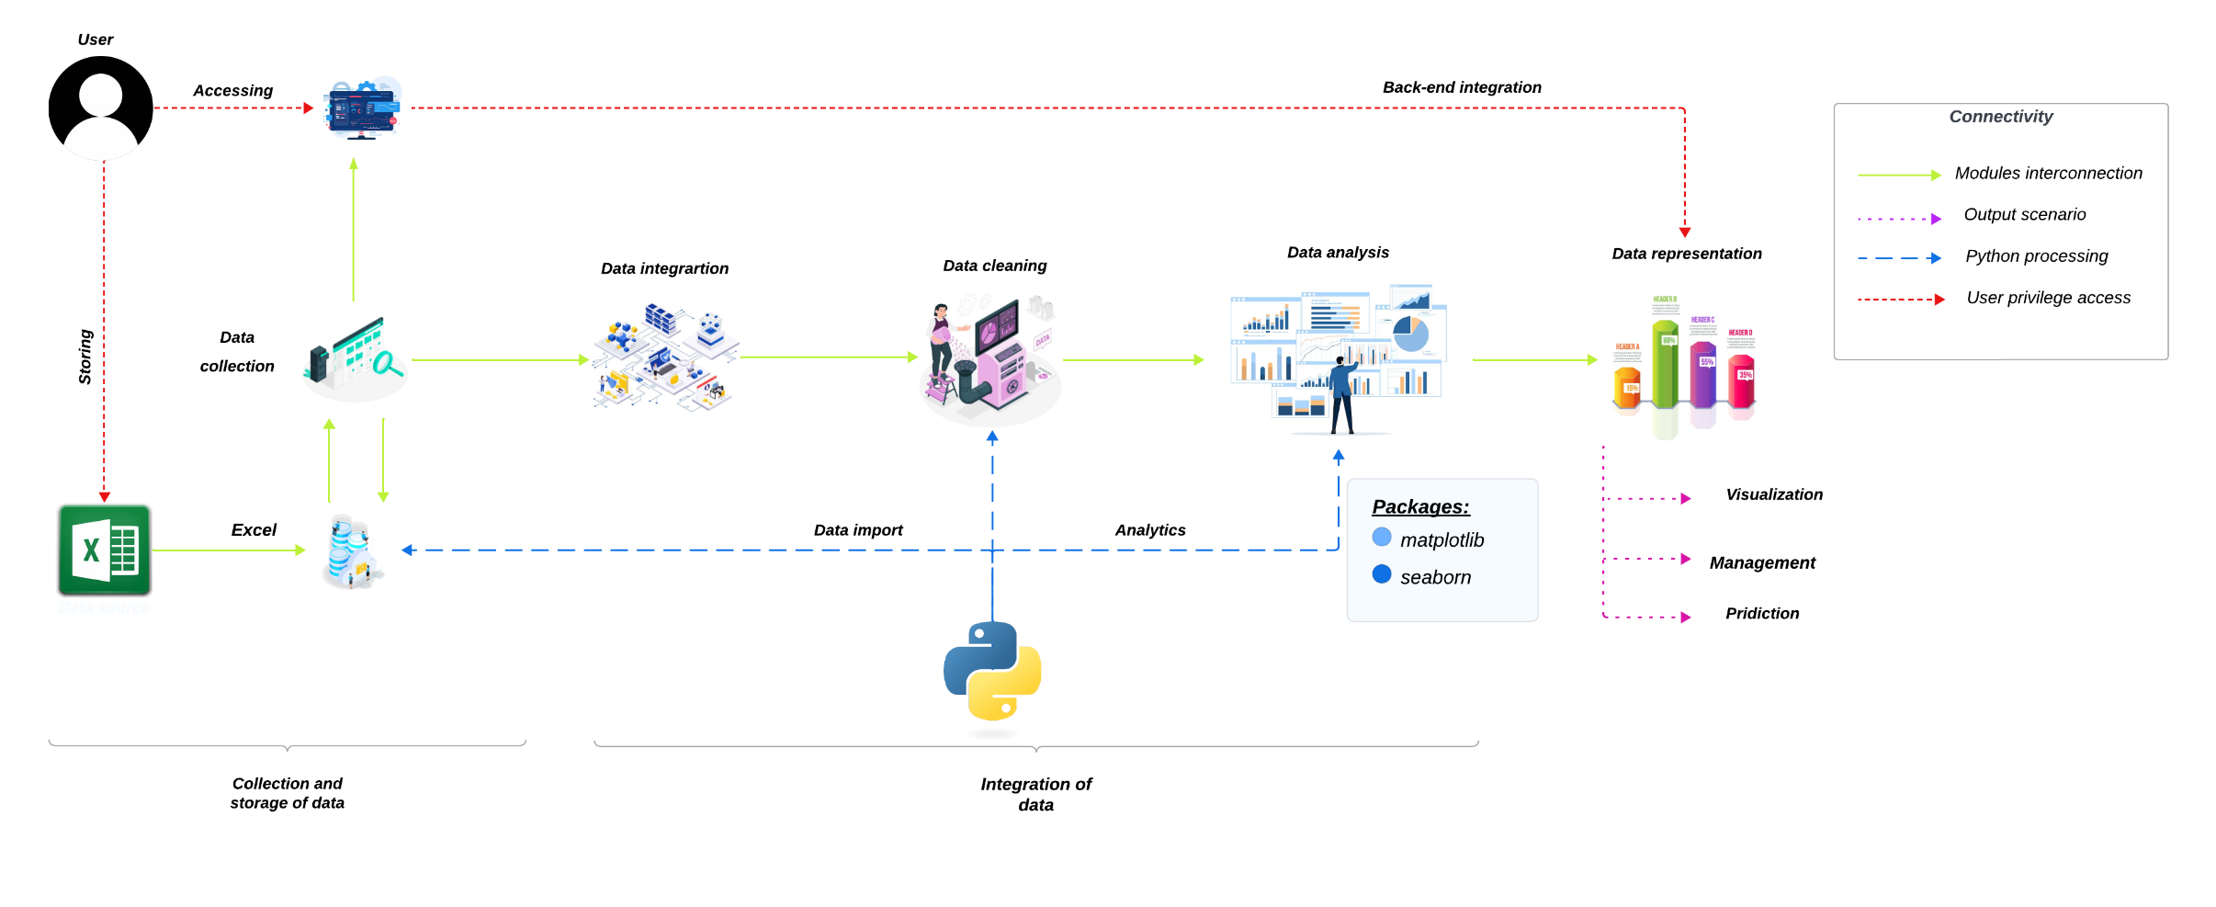

Architecture diagram:

Slide 13
Modules:
Data Cleaning and Preprocessing
Predictive Analytics in Healthcare
Descriptive Analytics
Prescriptive Analytics
Data Visualization and Reporting
. Compliance and Security
Case Studies and Real-World Examples

Slide 14
Hardware requirements:
Processor – Minimum Intel i5 (u)(h)
RAM – Minimum 8GB
Memory – Minimum 128 GB

Slide 15
Software requirements:
Operating System – Windows 10 or above
Tool – IBM Cognos Analytics
Database – Microsoft Excel 2007
Text Editor – Visual Studio (At least Version 1.64)
[Optional] Language – Python 3.9

Slide 16
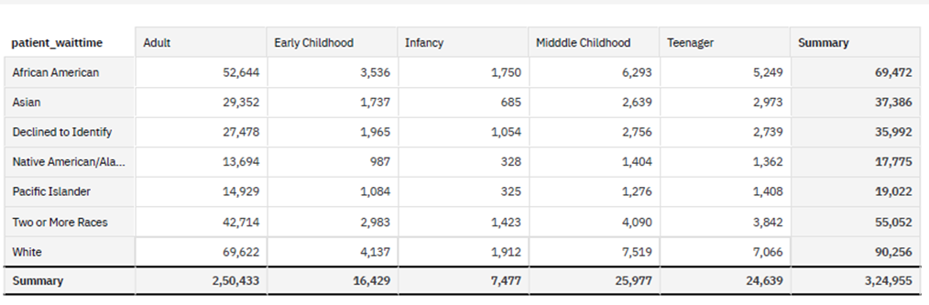
Experimental analysis:
You can’t tell immediately what is going on here or what insights you could get from this raw dataset
Here is where data analytics comes into the play

Slide 17
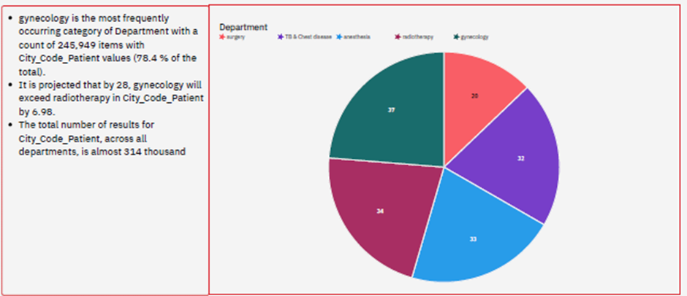
Experimental analysis:
In the analysis phase, we create separate visual representations for easy insights we can extract

Slide 18
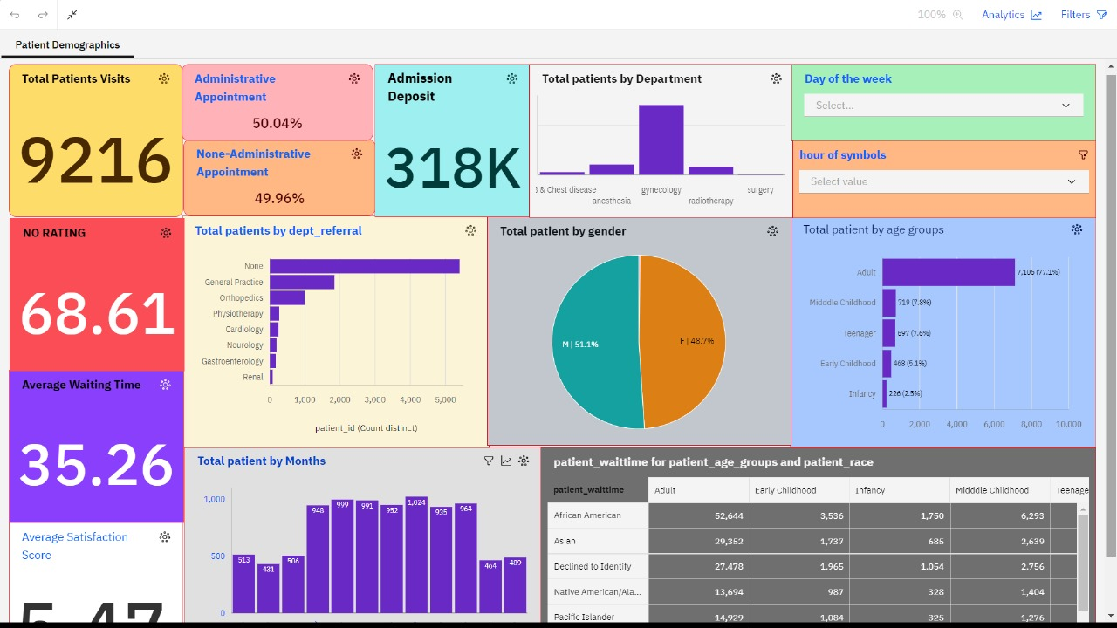
Screenshots – “SAMPLE IMAGE”

Slide 19
Advantages:
Improved Patient Outcomes
Enhanced Operational Efficiency
Cost Reduction
Data-driven Decision Making
Enhanced Patient Experience

Slide 20
Disadvantages:
Complex Implementation Process
Data Integration Challenges
Privacy and Security Risks
Resistance to Change
Technical Challenges
Ethical Considerations

Slide 21
Applications:
Patient Care Optimization
Operational Streamlining
Resource Allocation
Risk Management and Compliance
Research and Innovation
Performance Monitoring and Benchmarking

Slide 22
Conclusion:
In conclusion, the development of analytics for hospitals' health-care data presents a pivotal opportunity
Through the optimization of data utilization, hospitals can harness the power of advanced analytics to drive informed decision-making
By streamlining operations and enhancing efficiency, healthcare institutions can allocate resources more effectively

Slide 23
Future enhancements:
Predictive Analytics for Disease Management
Real-Time Health Monitoring
Drug Discovery and Development
Healthcare Operations Optimization
Fraud Detection and Prevention

Slide 24
References:
[1] Javier Nieto León, “Big Data In Healthcare 2021.”
https://www.htechtrends.com/big-data-in-healthcare/#:~:text=Big data in healthcare refers to the collection%2C, processed by machine learning techniques and data analysts.
[2] D. Chong and H. Shi, “Big data analytics: a literature review,” J. Manag. Anal., vol. 2, no. 3,pp. 175–201, 2015, DOI: 10.1080/23270012.2015.1082449
[3] Tutorialspoint, “Big Data Analytics Tutorial.”
https://www.tutorialspoint.com/big_data_analytics/index.htm.
[4] S. Kumar and M. Singh, “Big data analytics for the healthcare industry: Impact, applications, and tools,” Big Data Min. Anal., vol. 2, no. 1, pp. 48–57, 2019, DOI:10.26599/BDMA.2018.9020031.
[5] M. Ambigavathi, “Big Data Analytics in Healthcare,” 2018 Tenth Int. Conf. Adv. Comput., pp.269–276, 2018.

